Slide 1
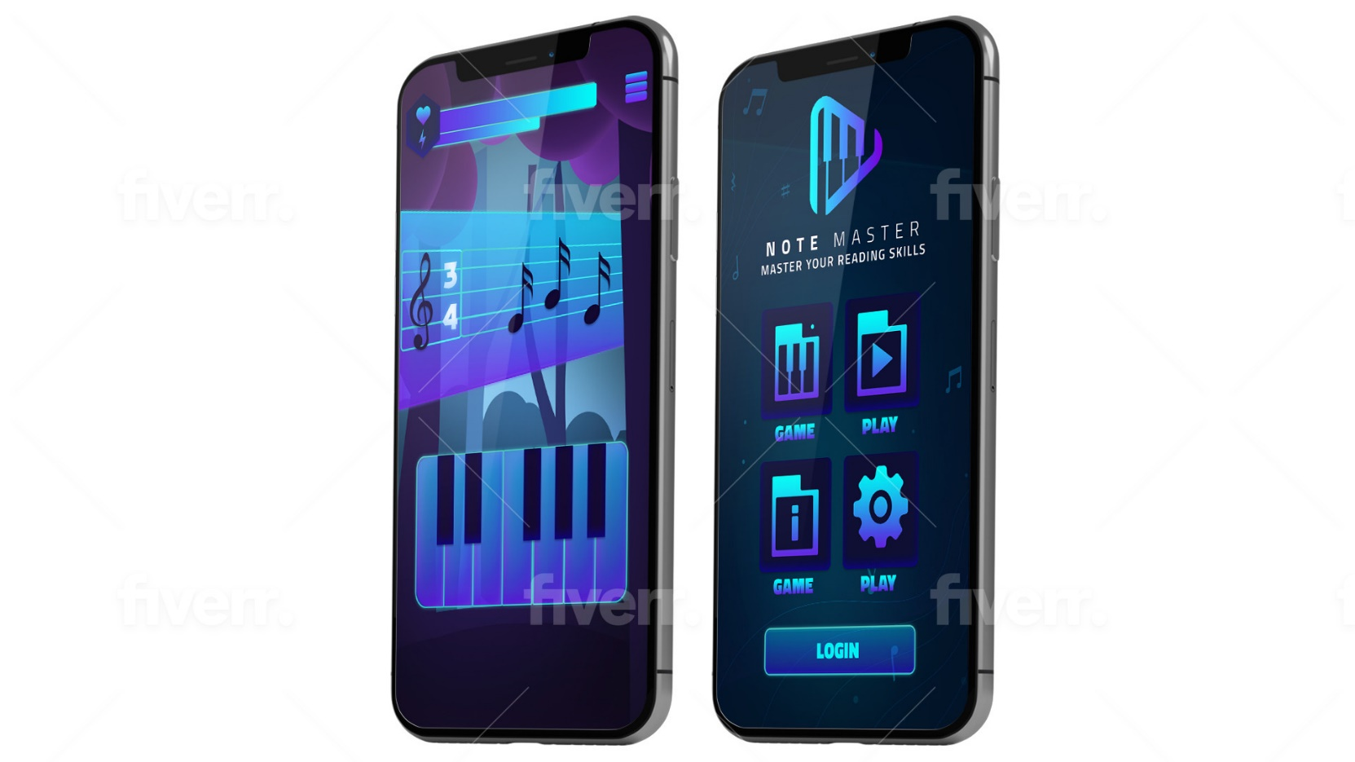
MUSIC APP DOCUMENTATION
1-PURPOSE OF THE DOCUMENT(page2)
2-APP WORKFLOW(page3)
3-FOLDERS STRUCTURE(page4)
4-INTERNAL ARCHITECTURE(page6)
5-ANATOMY OF EACH SCENE(page8)
6-CLASS REFERENCE(page13)

Slide 2
PURPOSE OF THE DOCUMENT
The purpose of this documet is to present the internal architecture of the applicatiion so that it can be understanded and modified by another developer without too much difficulty.

Slide 3

APP WORKFLOW
GAME SCENE
User click on game button
User click on native exit button
MAIN SCENE
User launch the app
User click on native exit button
User click on config button
USER
User click on back/native exit button
User click on config button
User click on native exit button
CONFIG SCENE
Exit App

Slide 4
FOLDERS STRUCTURE(1)
APKs
AUDIOS
SCENES
SCRIPTS
SPRITES
THEME
FONTS
MUSIC
HUDS
HUDS
CONFIGS
BGM
MAINS
PIANO
GAMEPLAY
SFX
OBJECTS
SCENEMANAGER
MAINMENU
APK: this folder will contain the different apk/aab builds of the app.
AUDIOS: this folder contains the different sounds of the application (music, bgm, sfx)
MUSIC: music are in this folder.
BGM: BGM are in this folder
SFX: sfx like piano key sounds are in this folder.
SCENES: this folder contains all scenes of the app (scenes of screens, scenes as prefab).
HUDS: all hud prefabs are in this folder.
MAINS: all the main scenes of the app are here(mainmenu scene, config scene, game scene, loading scene …).
OBJECTS: all prefab used in other scene are in this folder

Slide 5
FOLDERS STRUCTURE(2)
SCRIPTS: this folder contains all scripts of the application.
HUDS: all huds/ui scripts are in this folder.
PIANO: all the scripts concerning the piano's behaviour are in this folder.
SCENEMANAGER: all scripts for handle each main scene of the app is in this folder.
SPRITES: this folder contains all images of the application.
CONFIG: config scene images are in this folder.
GAMEPLAY: gameplay(where are played) scene images are in this folder.
MAINMENU: mainmenu scene images are in this folder.
THEMES: this folder contains all ui theme of the app.
FONTS: this folder contains all text fonts of the app.

Slide 6
INTERNAL ARCHITECTURE(1)
Mean Contain
MainMenu Scene
Config Scene
Game Scene
PianoView
PopupLeave
SheetView
Staff_note
MainMenu Scene: this scene is the front door of the application. it contains buttons that lead to other scenes (config, game). it is located in the main scenes folder.
Config Scene: this scene contains all the configuration of the application (tempo, background, ...). it is accessible from the mainmenu scene and from the game scene, it is located in the main scenes folder.
Game Scene: this scene is the most important one in the app. this is where the gameplay is played. it contains the piano view and the sheet view.

Slide 7
INTERNAL ARCHITECTURE(2)
PopupLeave: it is a scene(but used as prefab) that is called in the game scene to ask the user to confirm if he wants to leave the game scene or not.
PianoView: it is a scene(but used as prefab) that contains the view of the piano with all keys. it is called in the game scene.
SheetView: this is the scene(but used as prefab) that contains the sheet and is called in the game scene.
Staff_note: it is the scene(but used as prefab) that contains the musical note that appears in the music sheet.

Slide 8
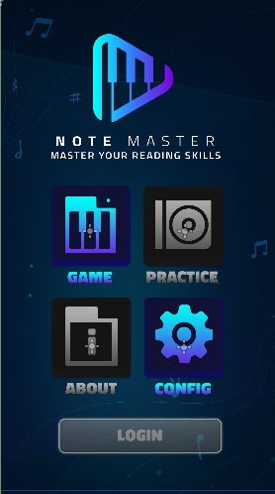
ANATOMY OF EACH SCENE(1)
MainMenu scene
this scene is handled by the script MainMenu.gd
When button down, call _on_btnGame_button_down() function and this function play scale animation
When button down, call _on_btnConfig_button_down() function and this functioin play scale animation
When button released, call _on_btnGame_pressed() function to go to game scene
When button config released, call _on_btnConfig_pressed() function to go to config scene

Slide 9
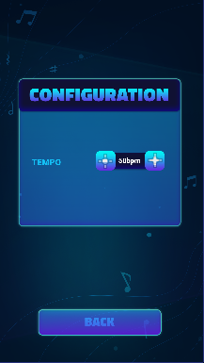
ANATOMY OF EACH SCENE(2)
When button down, call _on_btnAdd_button_down() function and this functioin play scale animation
Config scene
this scene is handled by the script ConfigMenu.gd
When button config released, call _on_btnConfig_pressed() function and this function:
Scale the button back to normal
- increase the value of tempo
When button down, call _on_btnBack_button_down() function and this function play scale animation
When button down, call _on_btnRemove_button_down() function and this functioin play scale animation
When button released, call _on_btn_pressed() function to go to game scene or main menu scene depending on the previous scene.
When button config released, call _on_btnRemove_pressed() function and this function:
Scale the button back to normal
Decrease the value of tempo

Slide 10
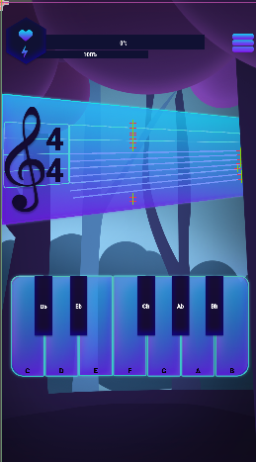
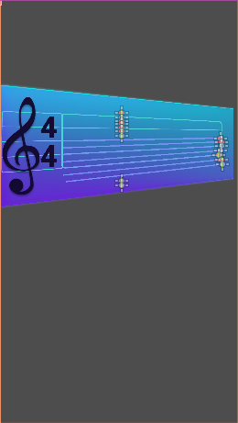
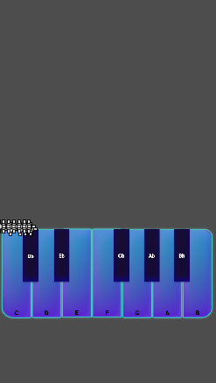
ANATOMY OF EACH SCENE(3)
When button down, call _on_btnRemove_button_down() function and this functioin play scale animation
GameScene scene
this scene is handled by the script GameScene.gd
When button released, call _on_btnConfig_pressed() function to go to config scene
view of the Sheet. it's an independent scene with its own behavior
the piano view. this view is an independent scene with its own behaviors

Slide 11
ANATOMY OF EACH SCENE(4)
PianoView scene
this scene is handled by the script PianoPlay.gd and it is used in the game scene
When button released, call _pressed() function to get the scale back to the normal,
Each piano key is handle by the script
Pianokey.gd
When Key down, call _button_down() function and this functioin :
-play scale animation
Play the sound according to the key pressed
Emit an on_pianokey_pressed event(this event will be use to evaluate the result after)

Slide 12
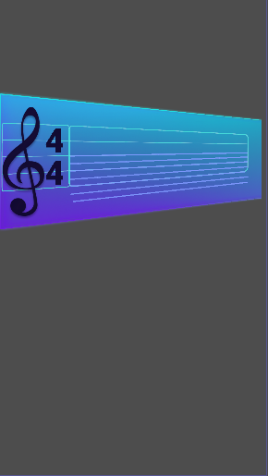
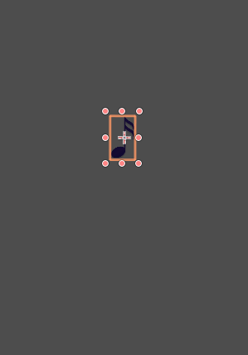
ANATOMY OF EACH SCENE(5)
SheetView scene
this scene is handled by the script SheetView.gd and it is used in the game scene
Instantiate here
Each line represents the postion of a note in the staff and is handled by the script StaffNoteLine.gd.
Note are instantiated on the right and move to the left on the corresponding line.
The staff note scene(used as prefab) to instantiate in the sheetview. After instantiation, the staff note move from right to letf,.

Slide 13
CLASS REFERENCE
Class references are in a Zip file on github. ClassReference.Zip
Download the zip.
Unzip it.
Open each file in your browser to view the content.

